Slide 1
Digital Logic
A | B | C
0 | 0 | 1
0 | 1 | 0
1 | 0 | 0
1 | 1 | 1
Express the truth table as the product of sums:
Use boolean algebra to derive the sum of products

Slide 2
Digital Logic
A | B | C
0 | 0 | 1
0 | 1 | 0
1 | 0 | 0
1 | 1 | 1
Express the truth table as the product of sums:
C = (A+B’) * (A’+B)
Use boolean algebra to derive the sum of products
C = (A’*A + A*B + A’*B’ + B’*B)
= (A’*B’ + A*B)

Slide 3
Digital Logic
Write the truth table for this circuit
Write the equation for this circuit using product of sums or sum of products

Slide 4
Digital Logic
A | B | C | Z
0 | 0 | 0
0 | 0 | 1
0 | 1 | 0
0 | 1 | 1
1 | 0 | 0
1 | 0 | 1
1 | 1 | 0
1 | 1 | 1
Write the truth table for this circuit
(A+B)’

Slide 5
Digital Logic
A | B | C | Z
0 | 0 | 0
0 | 0 | 1
0 | 1 | 0
0 | 1 | 1
1 | 0 | 0
1 | 0 | 1
1 | 1 | 0
1 | 1 | 1
Write the truth table for this circuit
(A+B)’+(B*C)’

Slide 6
Digital Logic
A | B | C | Z
0 | 0 | 0
0 | 0 | 1
0 | 1 | 0
0 | 1 | 1
1 | 0 | 0
1 | 0 | 1
1 | 1 | 0
1 | 1 | 1
Write the truth table for this circuit
(A+B)’+(B*C)’+(A*C)

Slide 7
Digital Logic
A | B | C | Z
0 | 0 | 0 | 1
0 | 0 | 1 | 1
0 | 1 | 0
0 | 1 | 1
1 | 0 | 0
1 | 0 | 1
1 | 1 | 0
1 | 1 | 1
Write the truth table for this circuit
(A+B)’ + (B*C)’ + (A*C) = (A’*B’) + (B’ + C’) + A*C

Slide 8
Digital Logic
A | B | C | Z
0 | 0 | 0 | 1
0 | 0 | 1 | 1
0 | 1 | 0 | 1
0 | 1 | 1
1 | 0 | 0 | 1
1 | 0 | 1 | 1
1 | 1 | 0 | 1
1 | 1 | 1
Write the truth table for this circuit
(A+B)’ + (B*C)’ + (A*C) = (A’*B’) + (B’ + C’) + A*C

Slide 9
Digital Logic
A | B | C | Z
0 | 0 | 0 | 1
0 | 0 | 1 | 1
0 | 1 | 0 | 1
0 | 1 | 1
1 | 0 | 0 | 1
1 | 0 | 1 | 1
1 | 1 | 0 | 1
1 | 1 | 1 | 1
Write the truth table for this circuit
(A+B)’ + (B*C)’ + (A*C) = (A’*B’) + (B’ + C’) + A*C

Slide 10
Digital Logic
A | B | C | Z
0 | 0 | 0 | 1
0 | 0 | 1 | 1
0 | 1 | 0 | 1
0 | 1 | 1 | 0
1 | 0 | 0 | 1
1 | 0 | 1 | 1
1 | 1 | 0 | 1
1 | 1 | 1 | 1
Write the truth table for this circuit
(A+B)’ + (B*C)’ + (A*C) = (A’*B’) + (B’ + C’) + A*C

Slide 11
Digital Logic
A | B | C | Z
0 | 0 | 0 | 1
0 | 0 | 1 | 1
0 | 1 | 0 | 1
0 | 1 | 1 | 0
1 | 0 | 0 | 1
1 | 0 | 1 | 1
1 | 1 | 0 | 1
1 | 1 | 1 | 1
Write the truth table for this circuit
(A+B)’ + (B*C)’ + (A*C) = (A’*B’) + (B’ + C’) + A*C
Write the equation for this circuit using product of sums or sum of products
Product of sums - A+B’+C’
Sum of products - A’B’C’ + A’B’C + A’BC’ + AB’C’ + AB’C + ABC’ + ABC

Slide 12
Multiplexor
Multiplexor circuit
Selects one data channel (from many input channels)
CONTROL LINES
2
0
1
2
3
INPUT DATA LINES
OUTPUT LINES

Slide 13
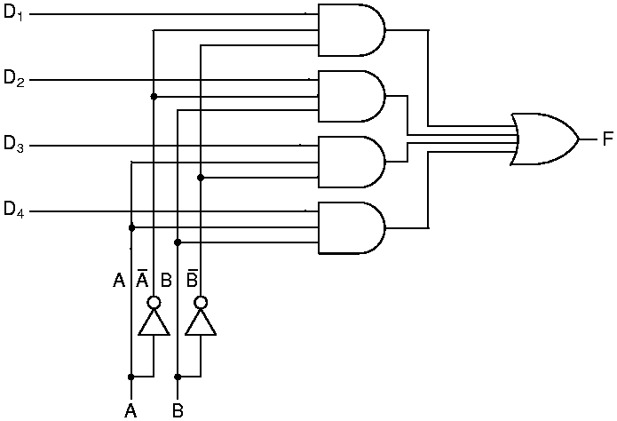
Multiplexor
Multiplexor circuit
Selects one data channel (from many input channels)
Maps the selected channel to the output channel
Sum-of-Products circuit
D₁ … D₄: Data channels
A, B: Control lines
F: Output channel
n control lines allows 2^{n} inputs
Example: To select D₁: A,B=0

Slide 14
If you need a multiplexor to choose which of 5 inputs, how many control lines do you need?

Slide 15
If you need a multiplexor to choose which of 5 inputs, how many control lines do you need?
The ceiling of log(5) = 3, so you would need 3 control lines

Slide 16
Decoder
Decoder circuit
Given n control lines
Select one of 2^{n} outputs to activate
CONTROL LINES
OUTPUTS - ONE IS ACTIVATED
3

Slide 17
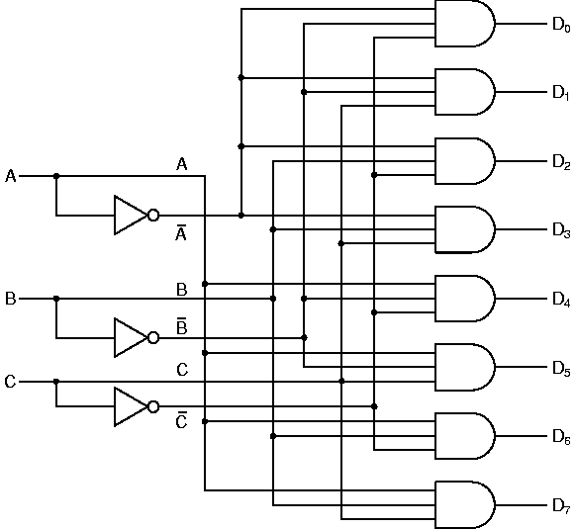
Decoder
Decoder circuit
Given n control lines
Select one of 2^{n} outputs to activate
Simple AND-gate circuit
D₁ … D₈ : Output channels
A, B, C : Control lines
Note: n control lines, 2^{n} outputs
Laws of Boolean Logic
Regulate circuit function
Identity Law 1 ∧ A = A, A∈{0,1}
Example: Select D₃: A, B, C = 0,1,1

Slide 18
If your decoder selects from among 40 outputs how many control lines does it need?

Slide 19
If your decoder selects from among 40 outputs how many control lines does it need?
The ceiling of log(40) = 6, so 6 control lines are needed
If you want to select the output channel 33, what should your control signals be?

Slide 20
If your decoder selects from among 40 outputs how many control lines does it need?
The ceiling of log(40) = 6, so 6 control lines are needed
If you want to select the output channel 33, what should your control signals be?
100001
Selecting a byte from memory is basically using a decoder.
32 bit memory addresses are used to select from 2³² addresses in memory

Slide 21
Comparator
Comparator circuit
Given two n-bit vectors A and B
Output 1 if A = B, or 0 otherwise
A
B

Slide 22
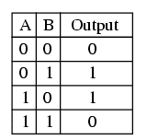

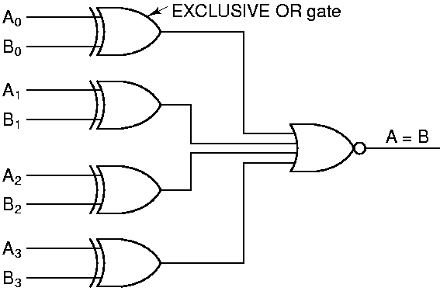
Comparator
Comparator circuit
Given two n-bit vectors A and B
Output 1 if A = B, or 0 otherwise
Simple XOR-gate circuit
A₀, A₁, …, A_{N-1} : Input vector #1
B₀, B₁, …, B_{N-1} : Input vector #2
Note: NOR gate combines N XOR gate outputs
If all inputs to this NOR gate are zero, output is 1
Laws of Boolean Logic
Example: Comparator for Bit i outputs 0 if A_{i} = B_{i}

Slide 23
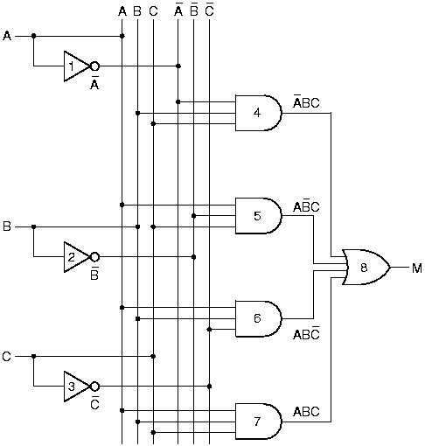
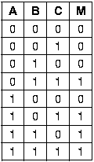
Majority vote circuit
Majority Function
Returns 1 if a majority of inputs are high (=1)
Formula: M(A,B,C) = A’BC + AB’C + ABC’ + ABC
Truth Table ⇒ SOP Circuit:
[Note: A = NOT(A)]
Application: In the Space Shuttle, 3 redundant circuits each compute the same function f. If a MAJORITY of circuit outputs agree (=1), then the 1-valued result is assumed to be correct.

